Slide 2
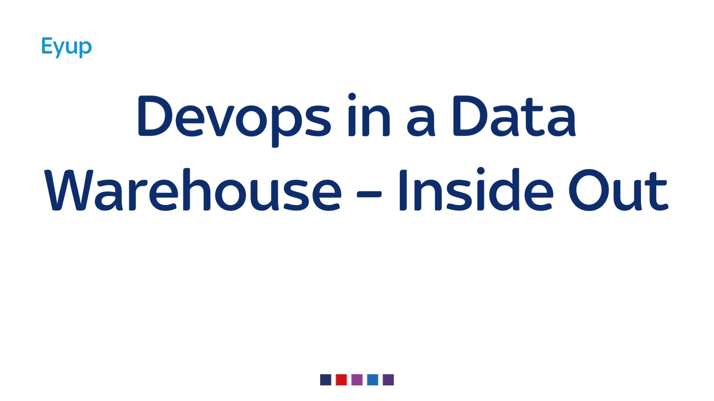
Notes:
Not web scale
Inside out, bottom up,Grassroots talk – like debois and scafer
Not man consultants, tcos

Slide 3
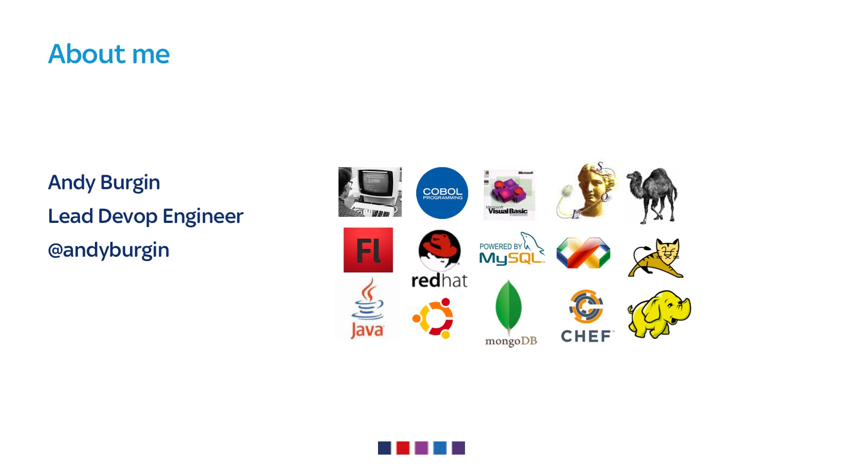
Notes:
I’m not
Im….
Twitter troll
Youthfull good looks
Done a lot
WHAT I DO

Slide 4

Notes:
WHAT DO SKYBET DO
ONLINE BOOKIES
SPORTS – all top sports- footbal, horse racing, greyhounds, golf, tennis, Bgt, elections
Games SLOTS, Roulette, POKER, BINGO
Some free to play offerings and our odds checker service

Slide 5

Notes:
We’ve been doing devops for a while

Slide 6
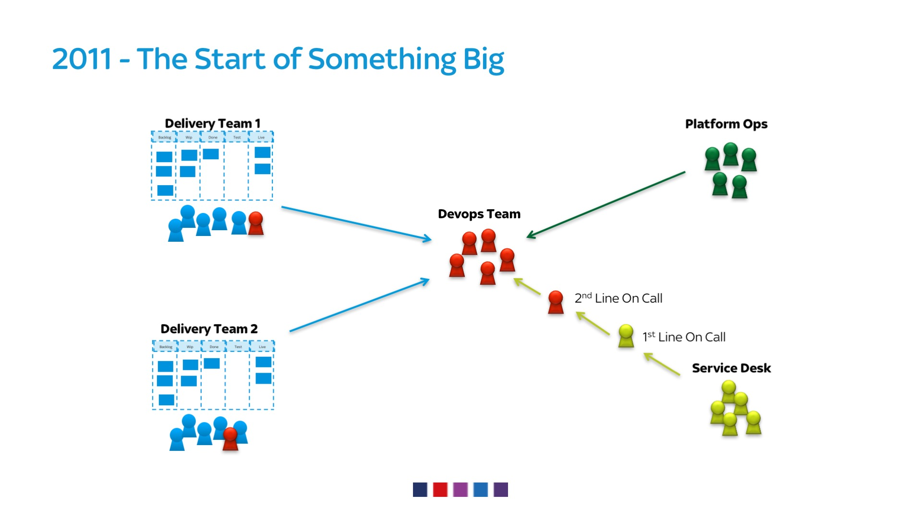
Notes:
Started with a couple of teams building front end and supporting server technologies
Releasing tooling ci etc

Slide 7
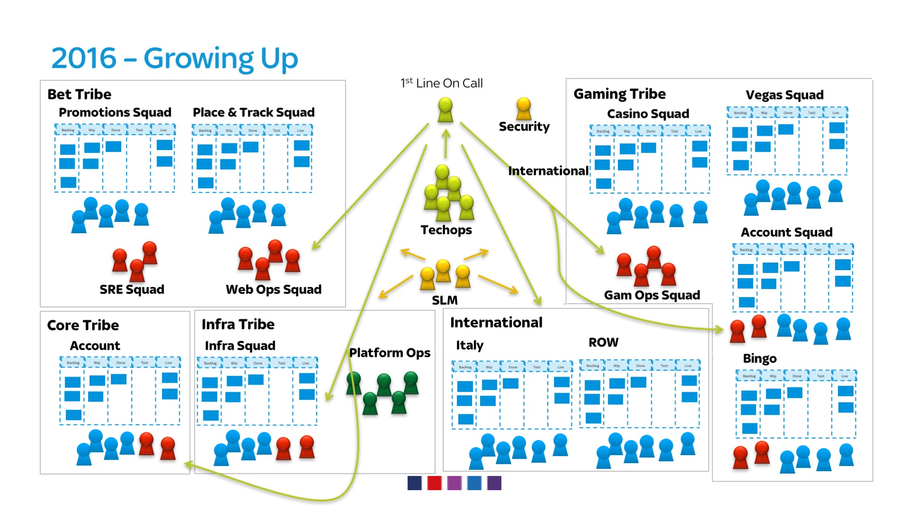
Notes:
Spotify – autonomous agile delivery teams
Notice some some devops squads, some embedded in squads

Slide 8
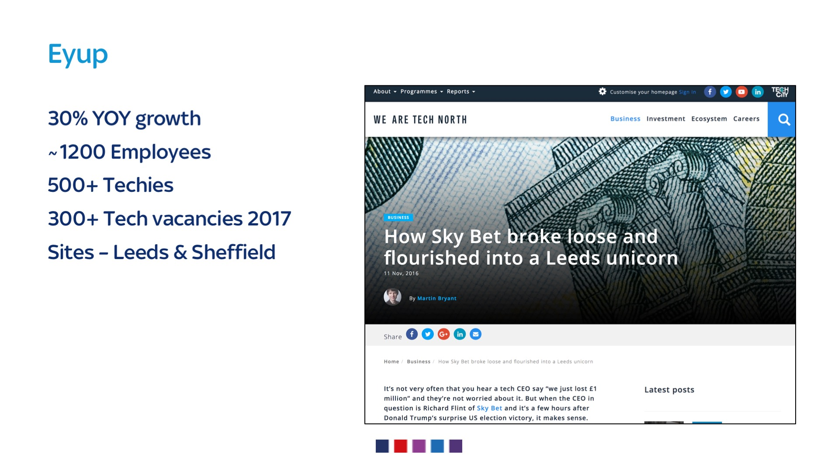
Notes:
Devops been key in growth
30% yoy growth
Multi site
Local media refers to us as a unicorn

Slide 9

Notes:
But not every tribe is that advanced in devops adoption

Slide 10
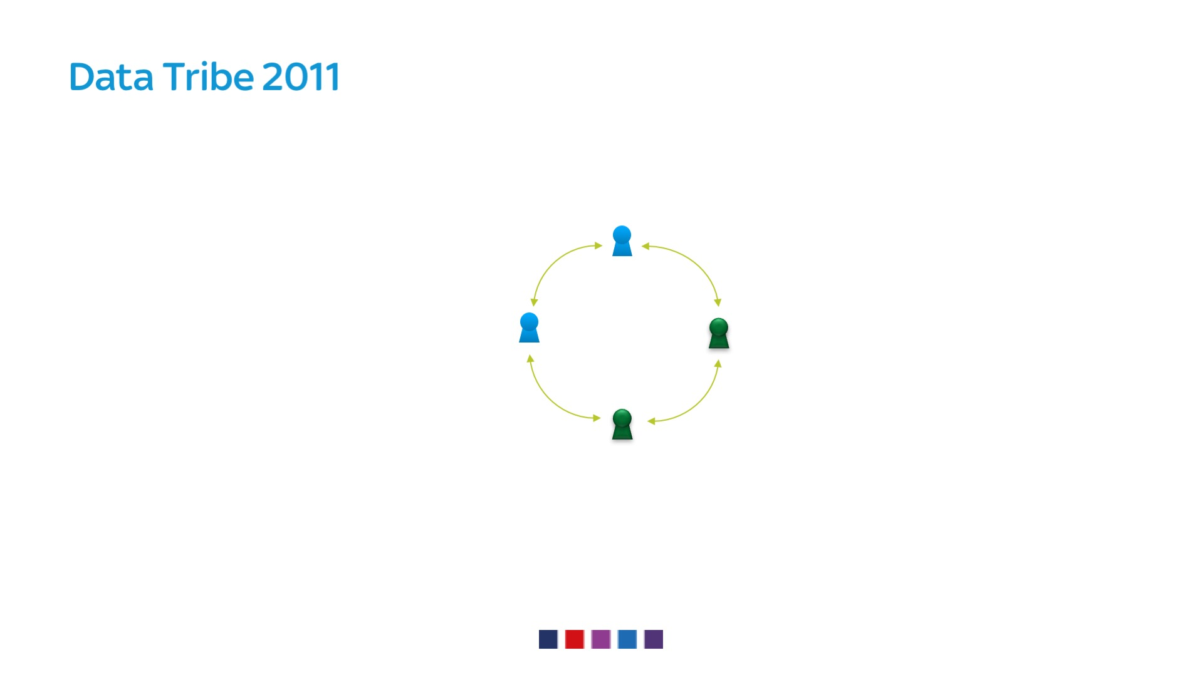
Notes:
Few people working on sky dwh

Slide 11
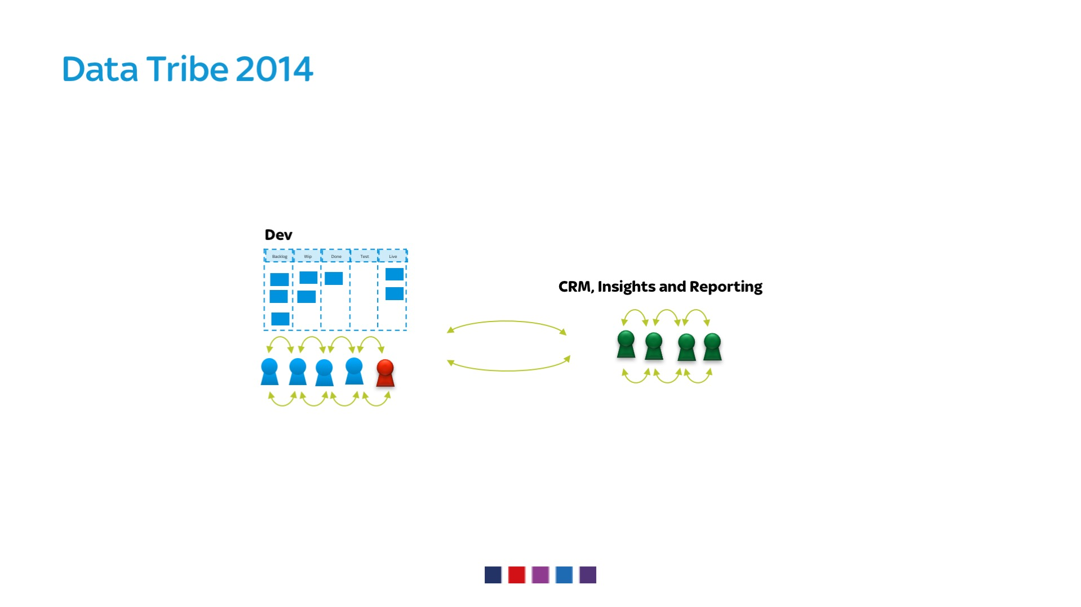
Notes:
Filled the cluster
Built or own
Small team with devop implemented the cluster

Slide 12
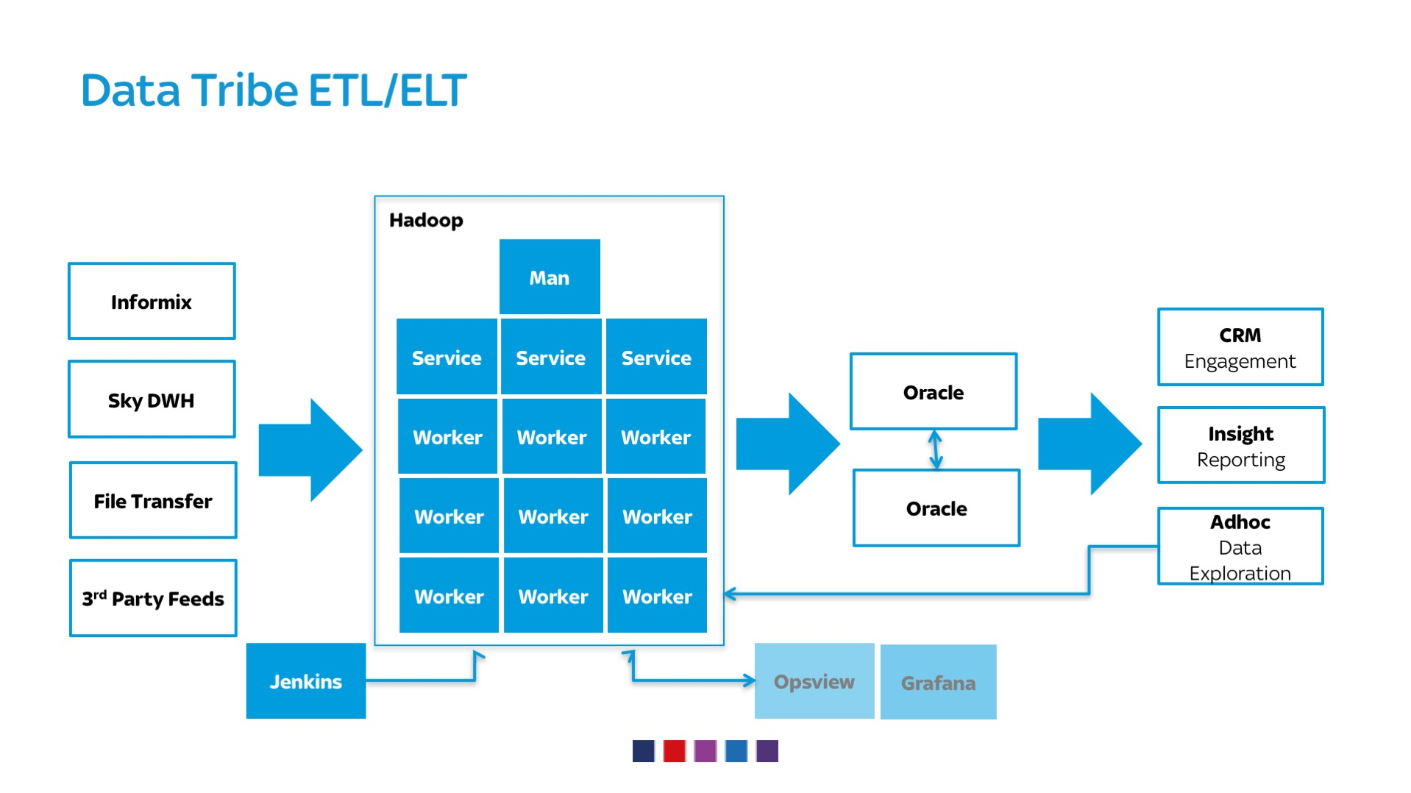
Notes:
The stack ingests data
analyses
Enriches
consumed by CRM and reporting tools
Loads of unique BI/MI competitors didn’t have
We want more

Slide 13

Notes:
Worked well
Business wanted a data driven business

Slide 14
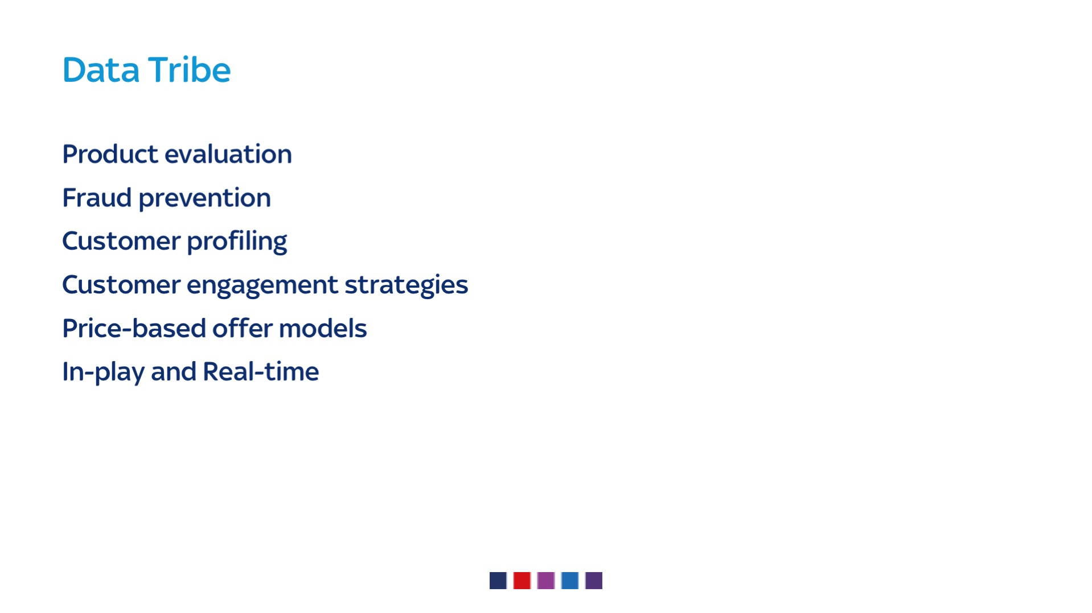
Notes:
We were tasked with…
Business functions
prevent churn
Segmentation
personalisation
more real time stuff

Slide 15
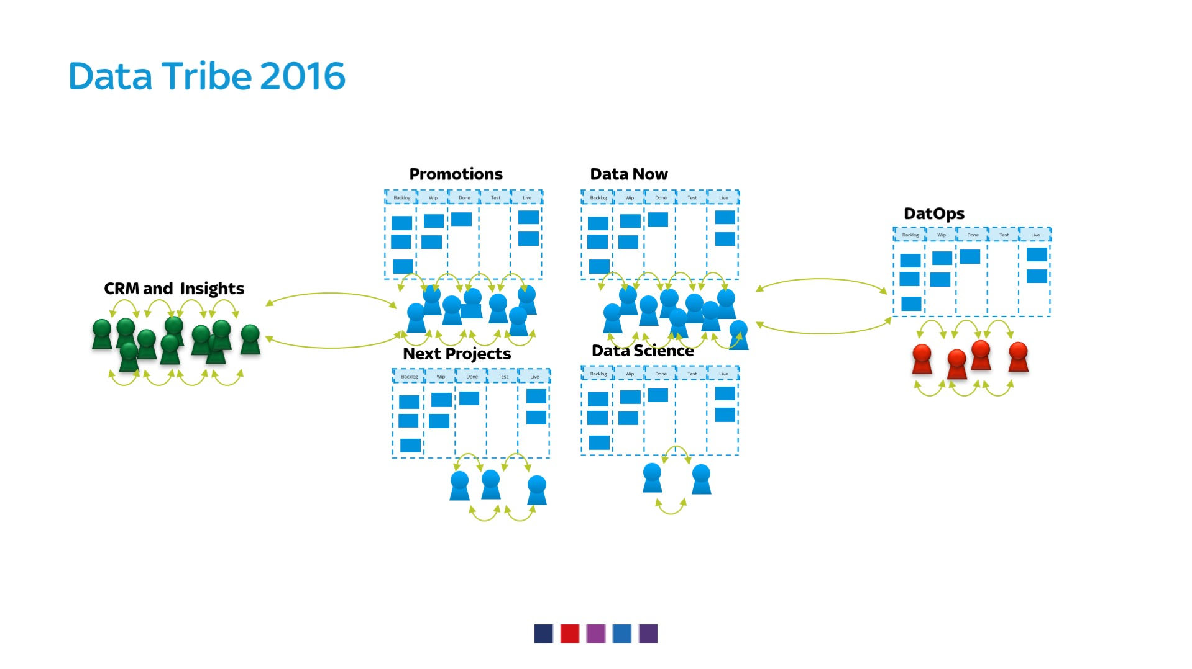
Notes:
So scaled up
Now 4 dev teams – now, promo, next, science
And a dedicated ops team

Slide 16
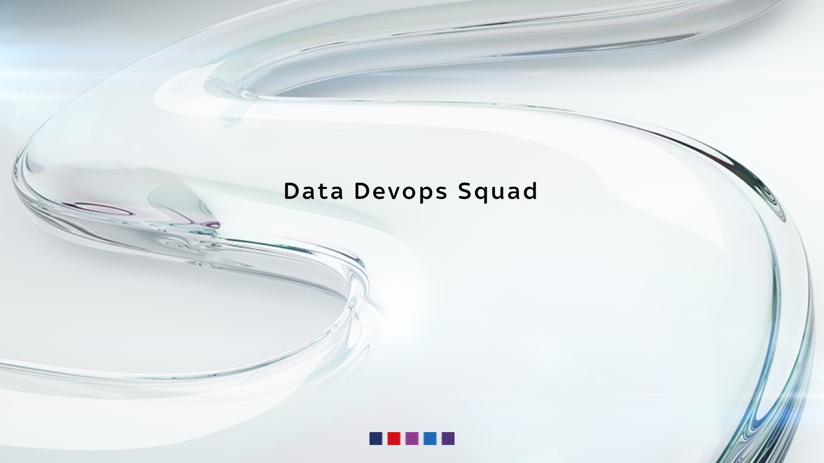
Notes:
Dedicated devops function

Slide 17
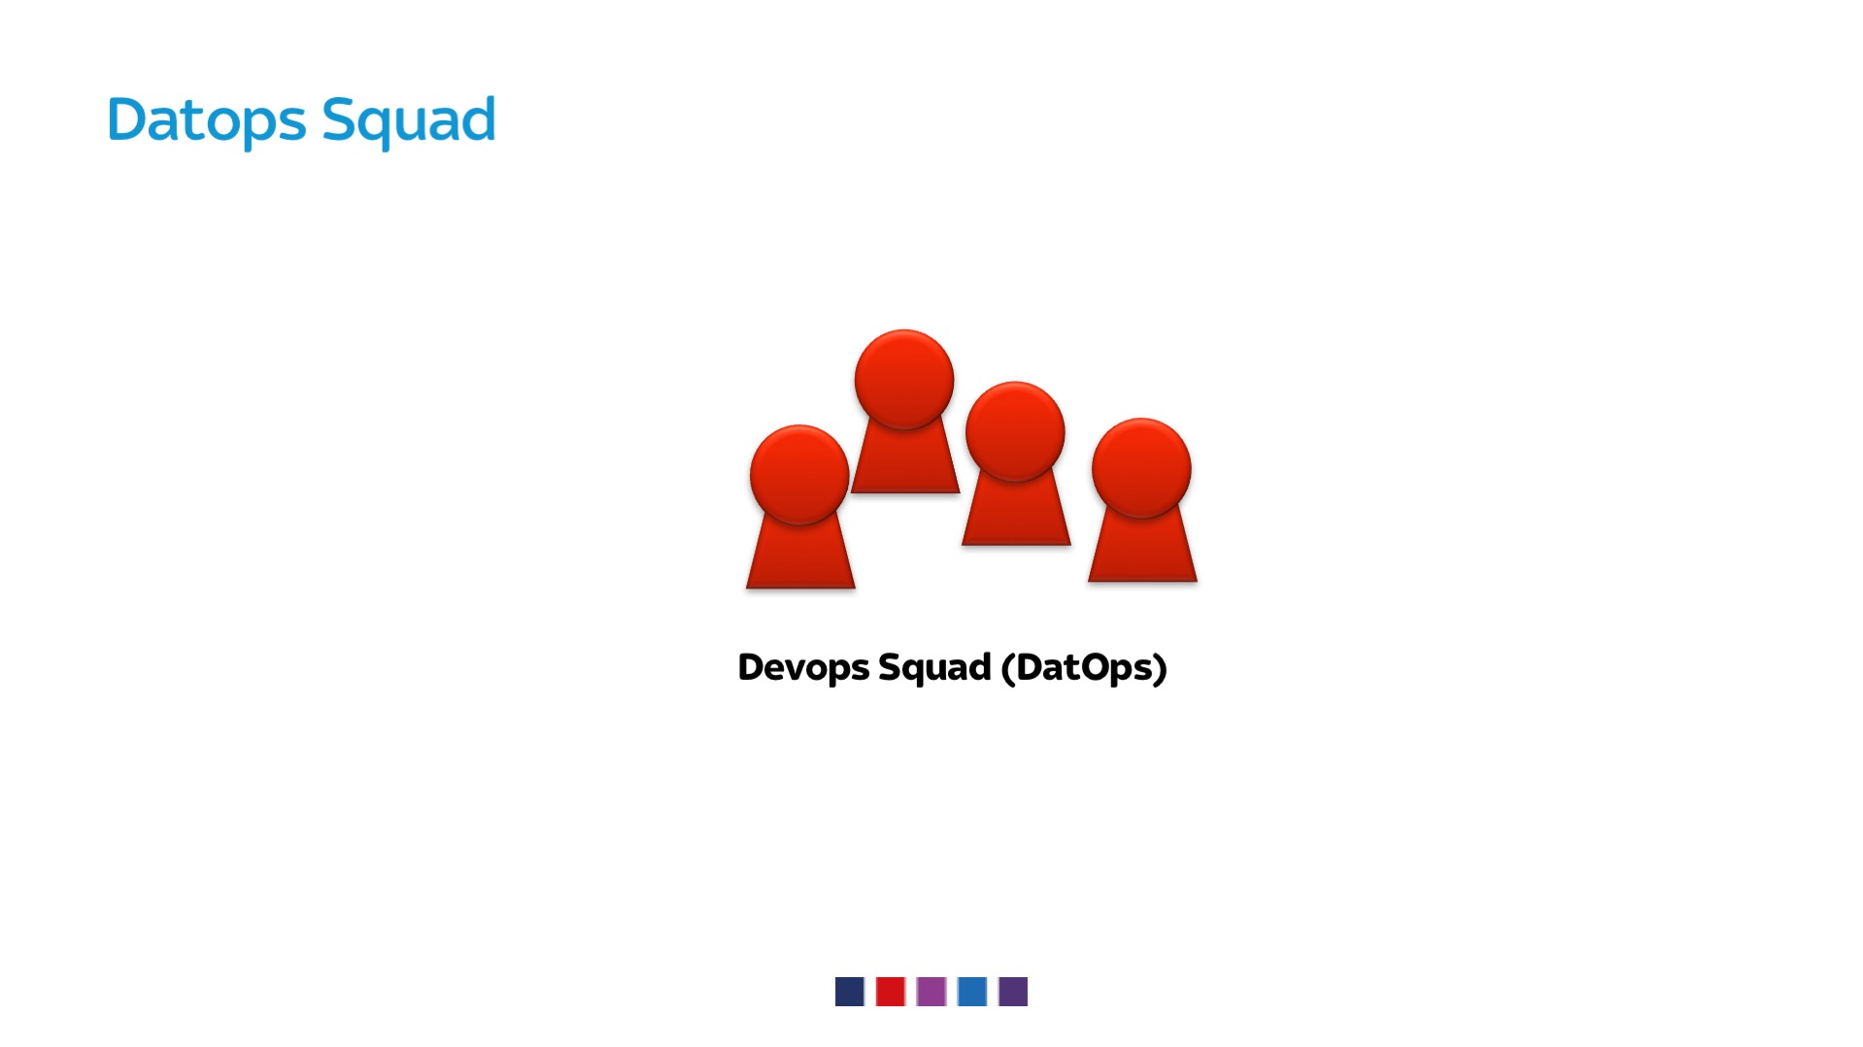
Notes:
Established tooling team
Python
IAC
Dev background

Slide 18
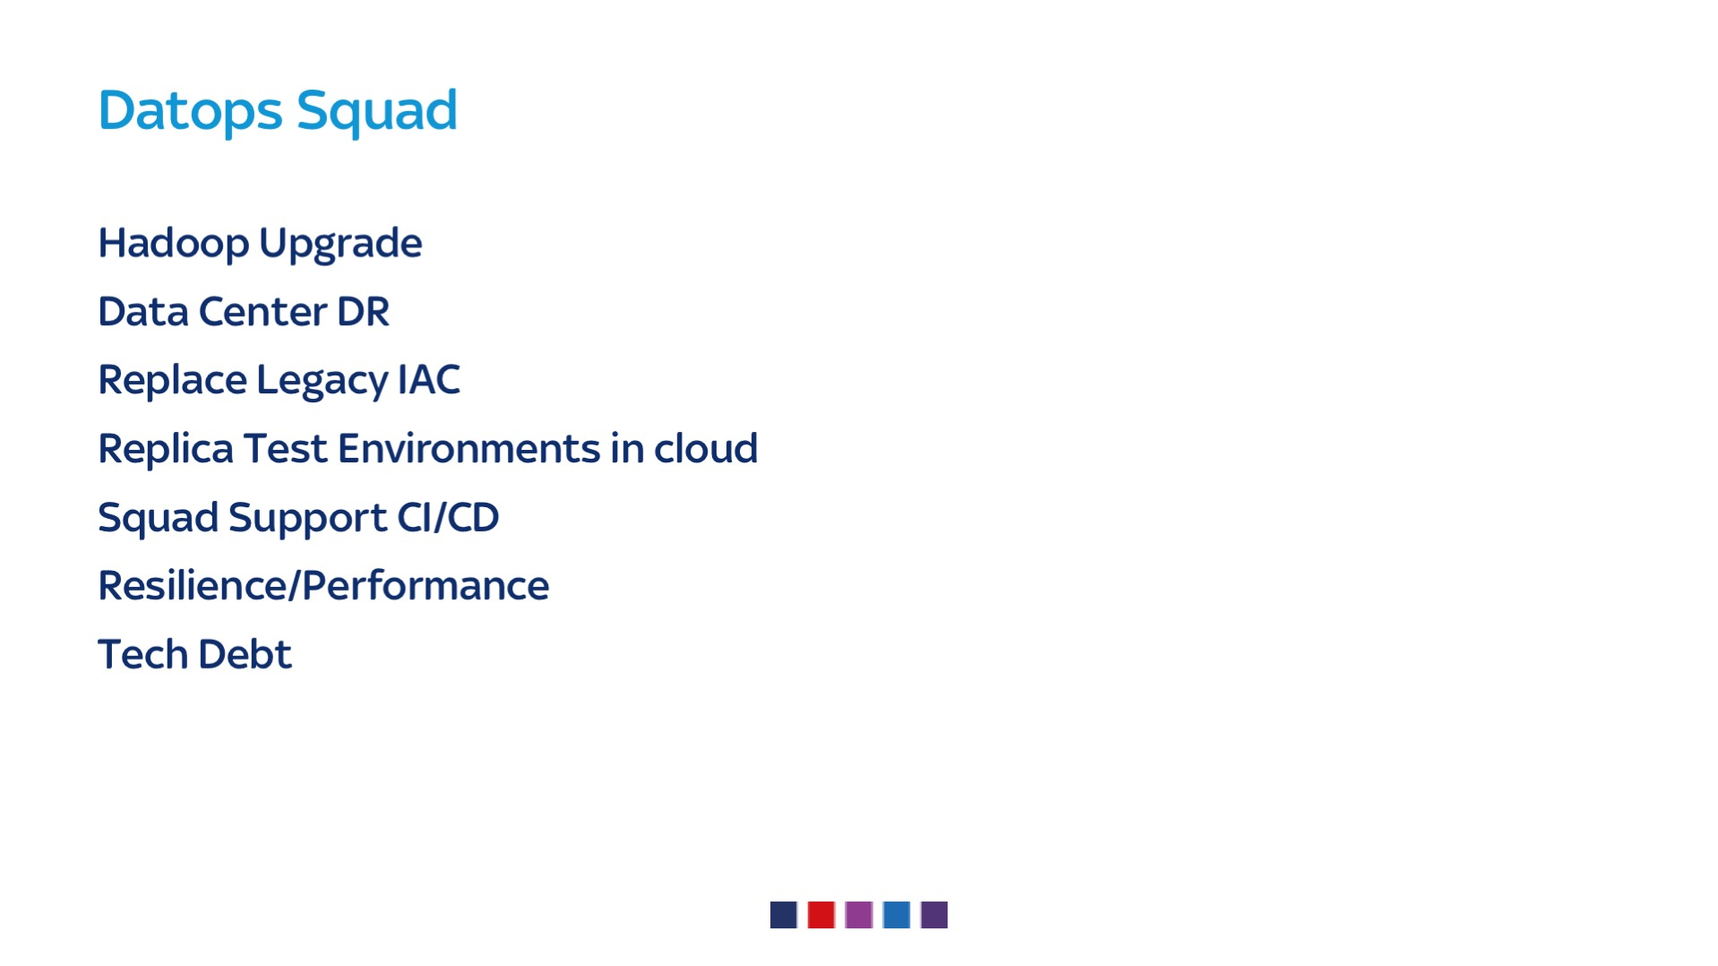
Notes:
Improve platform performance and reliability
De snoflake – remove all that build up on manual installs
Test envs
Support dev teams

Slide 19
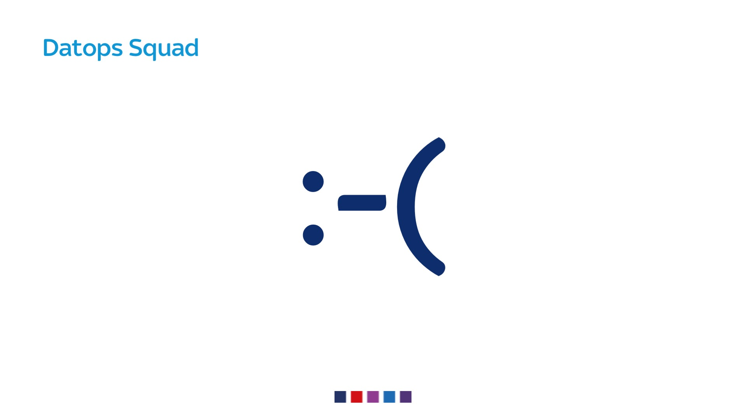
Notes:
But there is a problem
We’re not happy

Slide 20
Notes:
We are being swampped by small requests from the dev teams
We arent getting our stuff done
Becoming the fix it team
Not using our skills
Collaborative vicious cycle

Slide 21

Notes:
So we went and looked for an answer

Slide 22
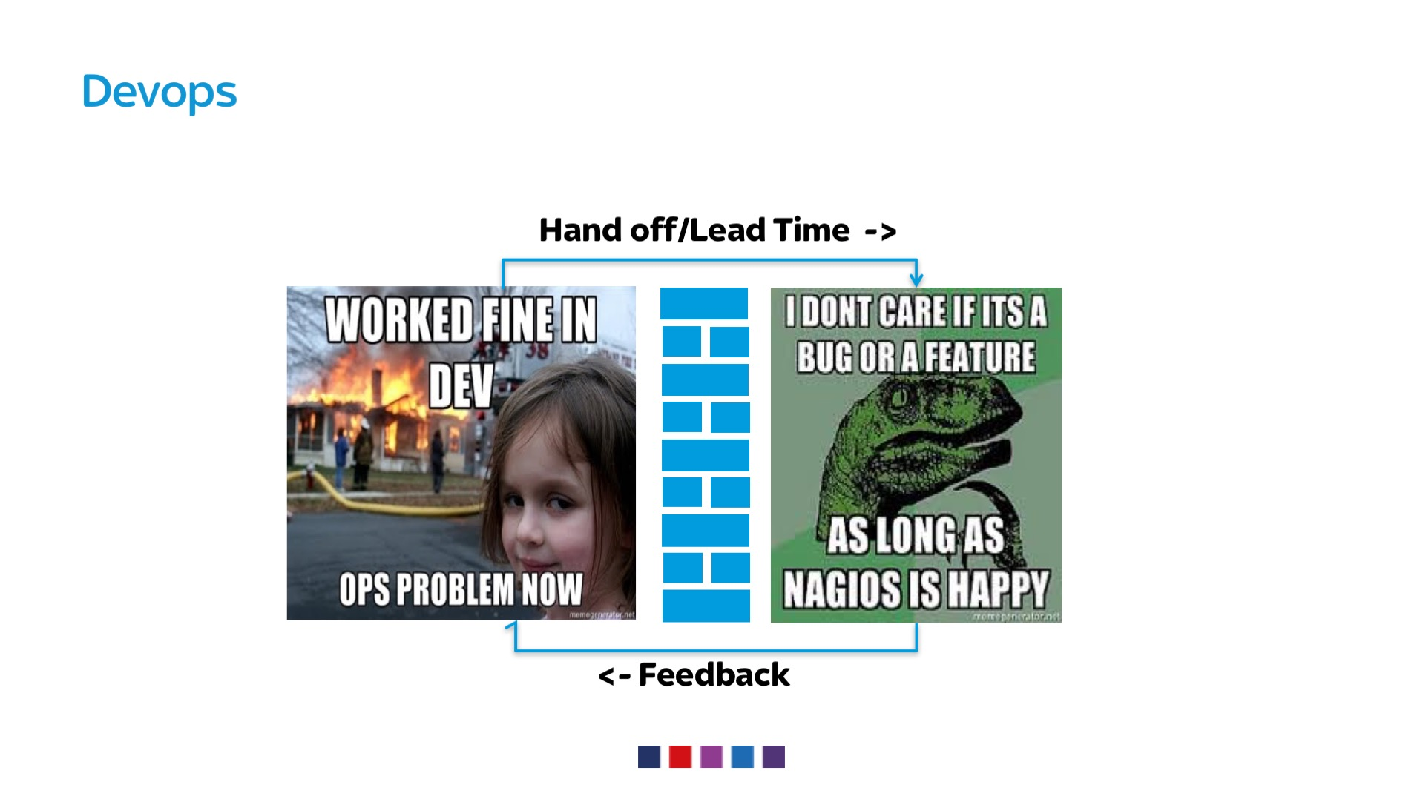
Notes:
WE SHOULD ALL KNOW
We talk about functional silos
Misaligned incentives –features vs uptime
Wall – don’t talk
The worse cases leads to infighting
Etc, etc, etc…
Prefer Applying lean principles to the IT value stream

Slide 23
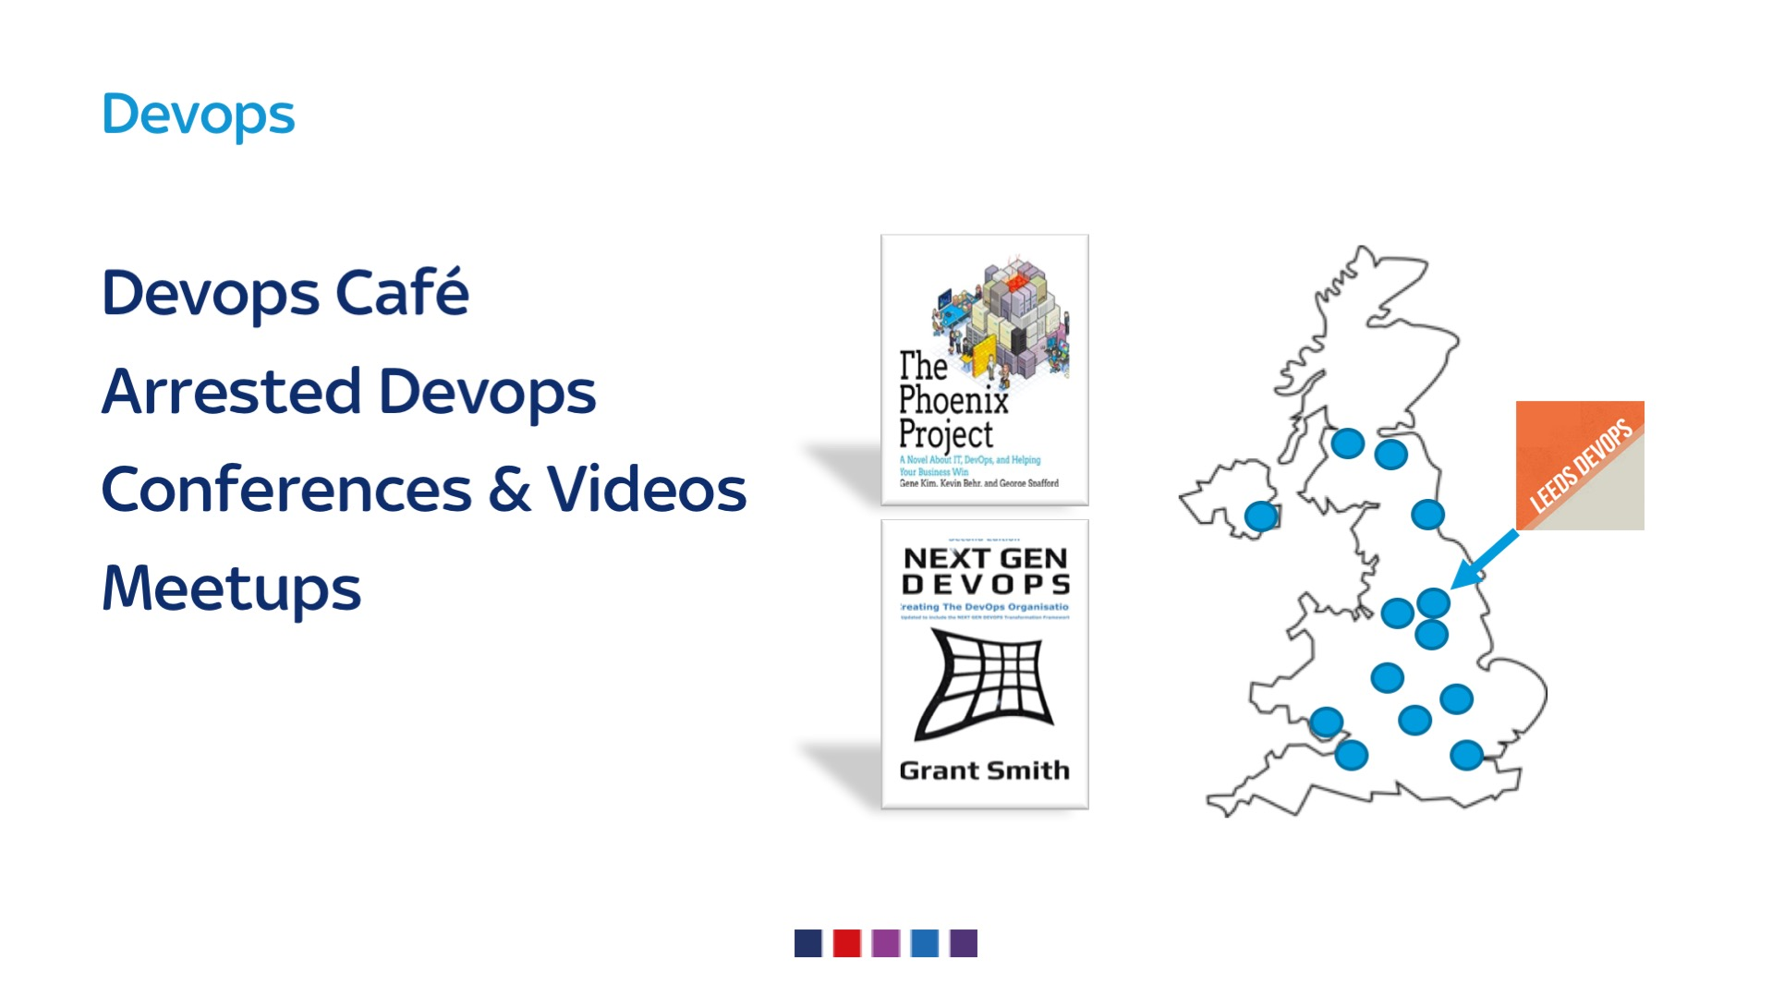
Notes:
Learned from....
Podcasts
Conferences
Videos
Meetups leeds, go
Books
Pheonix project
Nextgen devops
Devops hand book
Effective devops – katherine daniels and jennifer davies

Slide 24
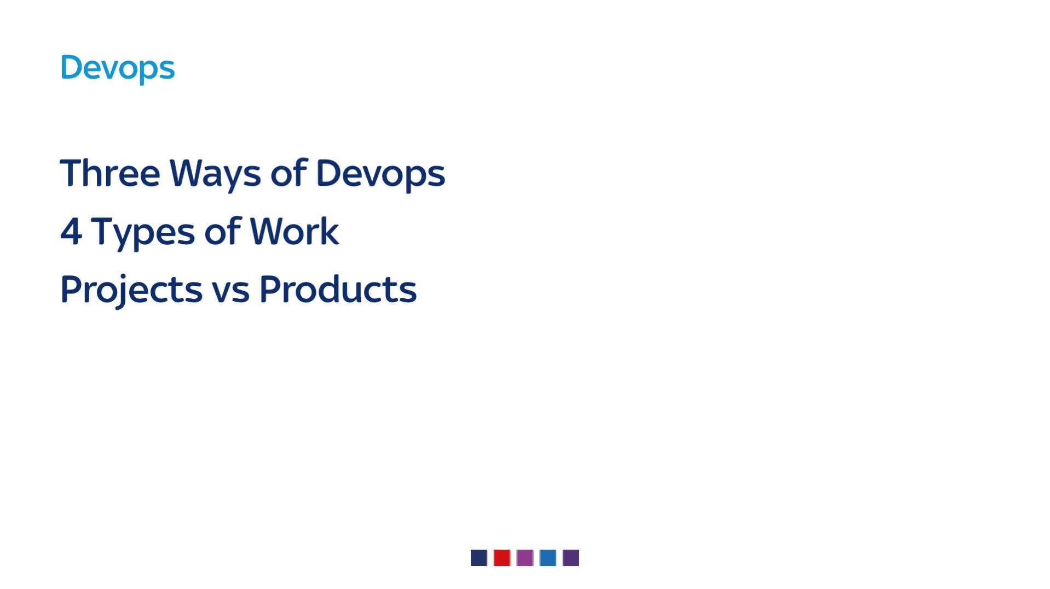
Notes:
These are the areas were we thought we might find answers

Slide 25

Notes:
3 Ways…

Slide 26
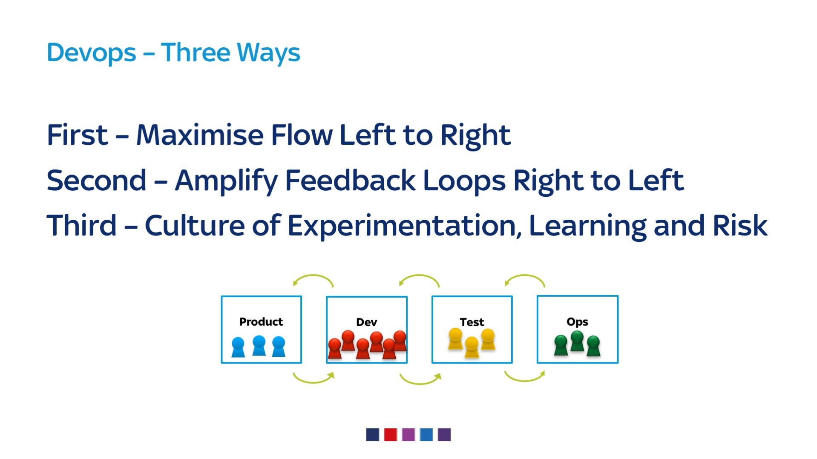
Notes:
Applying lean to SDLC
1 – FLOW - faster, communicated, lead times, small batches
2 – UDON CHORD - ensure everyone down stream know there is a problem and have visibility
3 – LEARNING - kaizen, constantly improve, learning organisation

Slide 27
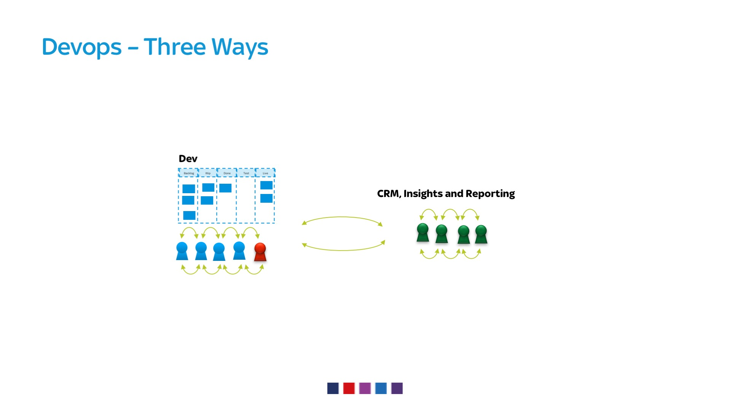
Notes:
Culture ok – lunch, beers, mates
We were the constraint but how
Previous incarnation devop was rockstar – relied upon
Kata was wrong - Working in the same way – need some rules of engagement

Slide 28

Notes:
Projects are temporary, products are permanent

Slide 29
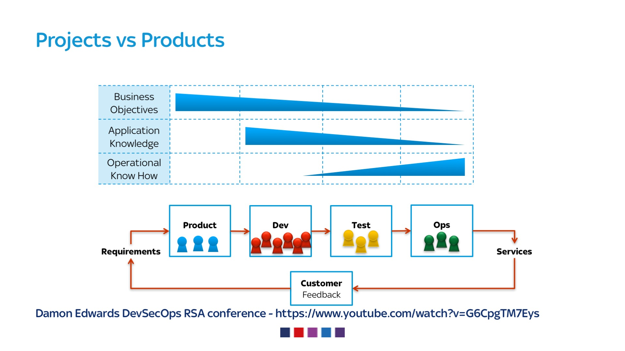
Notes:
STOLEN BLATENTLY FROM DAMON
In a functional team set up
Problem
As handoffs between teams – you loose knowledge – works back the other way

Slide 30
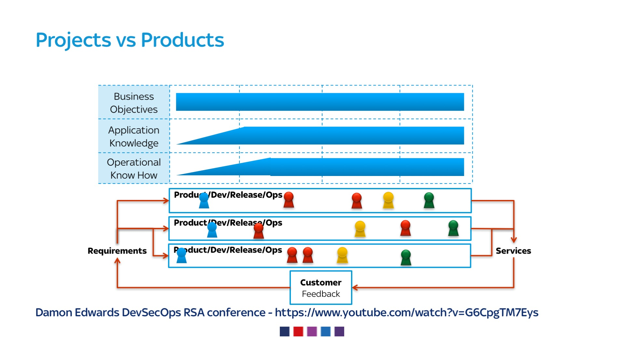
Notes:
If you take exactly the same people and put on product teams
Knowledge doesn’t dissipate, same people sharing same meetings, briefings
Team owns and supports it – pride in ownership
Responsibility leads to AUTONOMY, MASTERY, PURPOSE

Slide 31
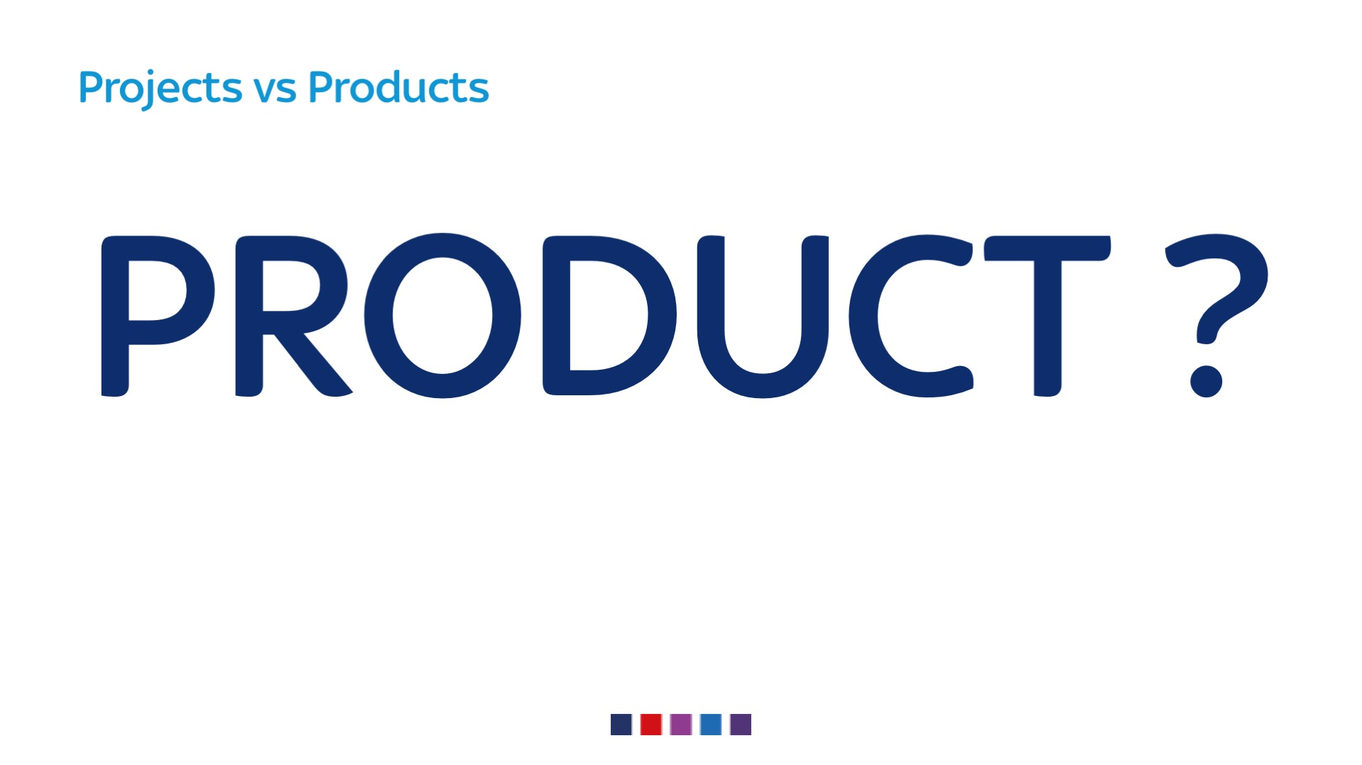
Notes:
What was our product or service

Slide 32
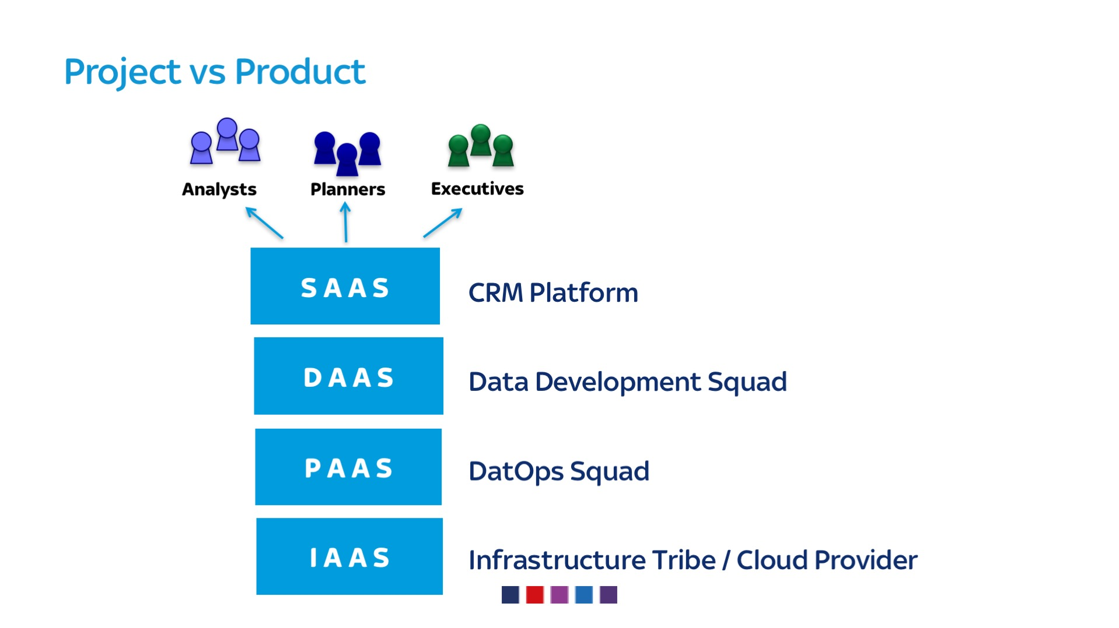
Notes:
IAAS = tin & vm to os
PAAS =hadoop
DAAS= applcation out put from dev teams
SAAS= crm systems

Slide 33
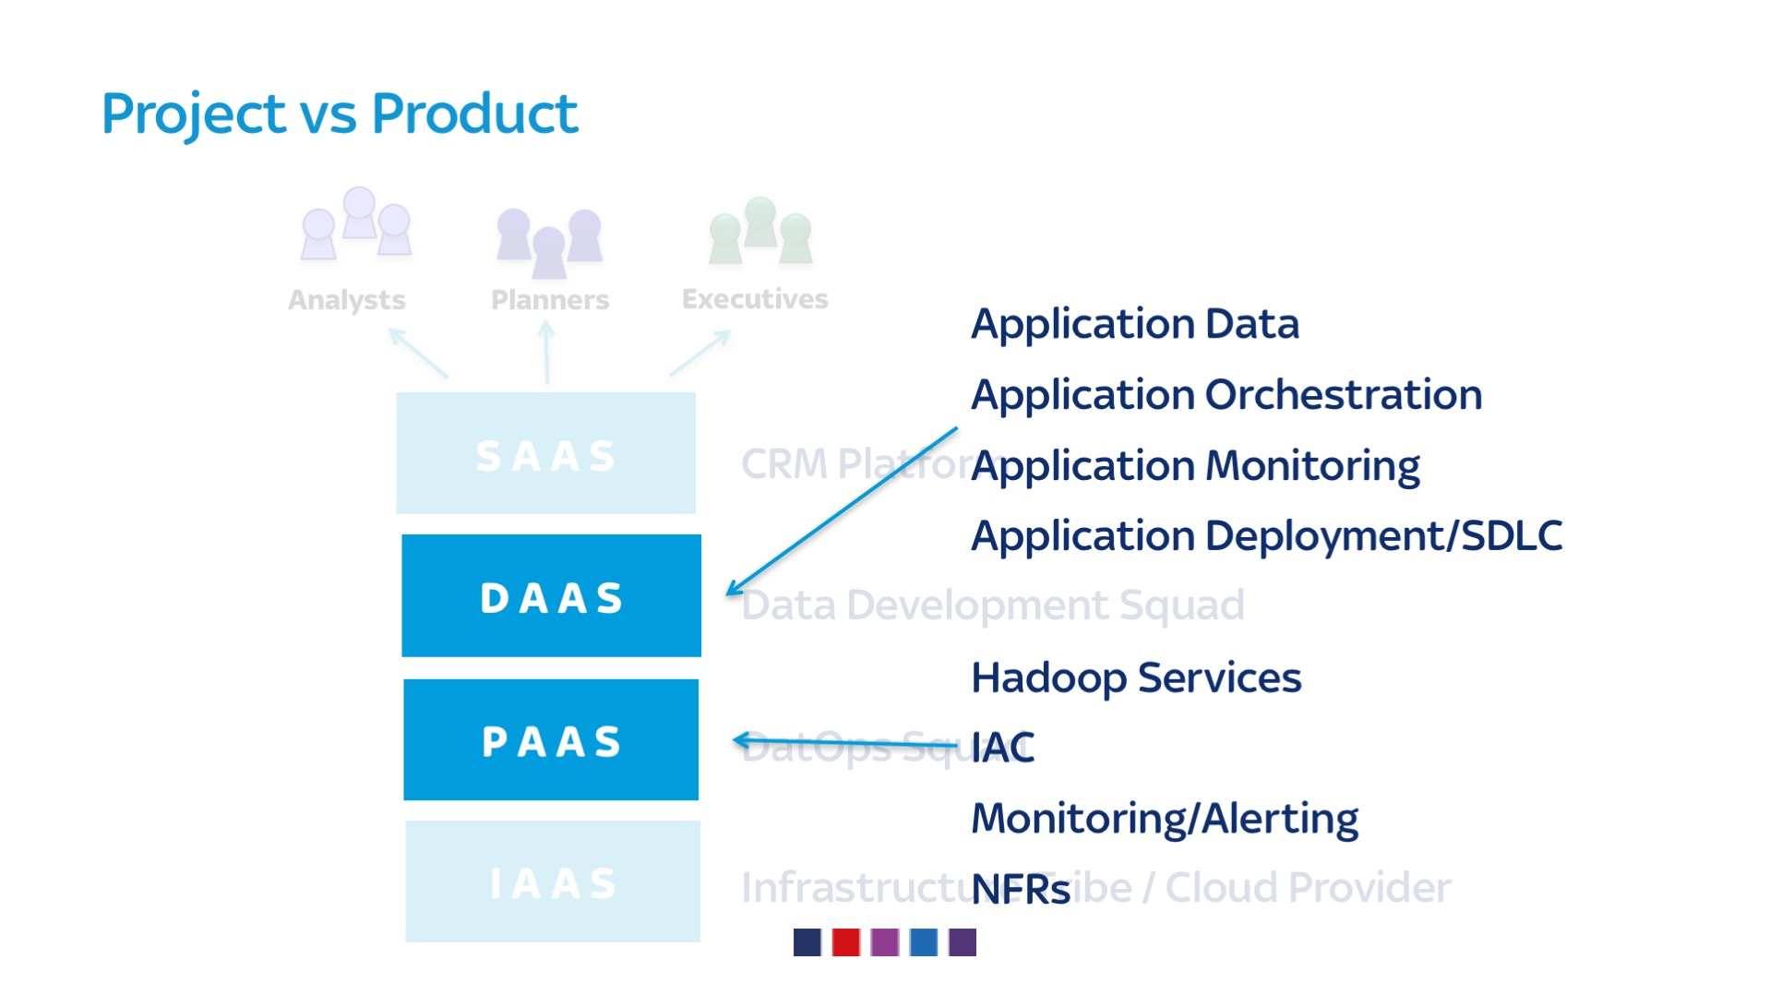
Notes:
What should be the responsibilities for nfrs ?
We were getting asked to do them
We can use services to reestablish the rules without being teflon

Slide 34
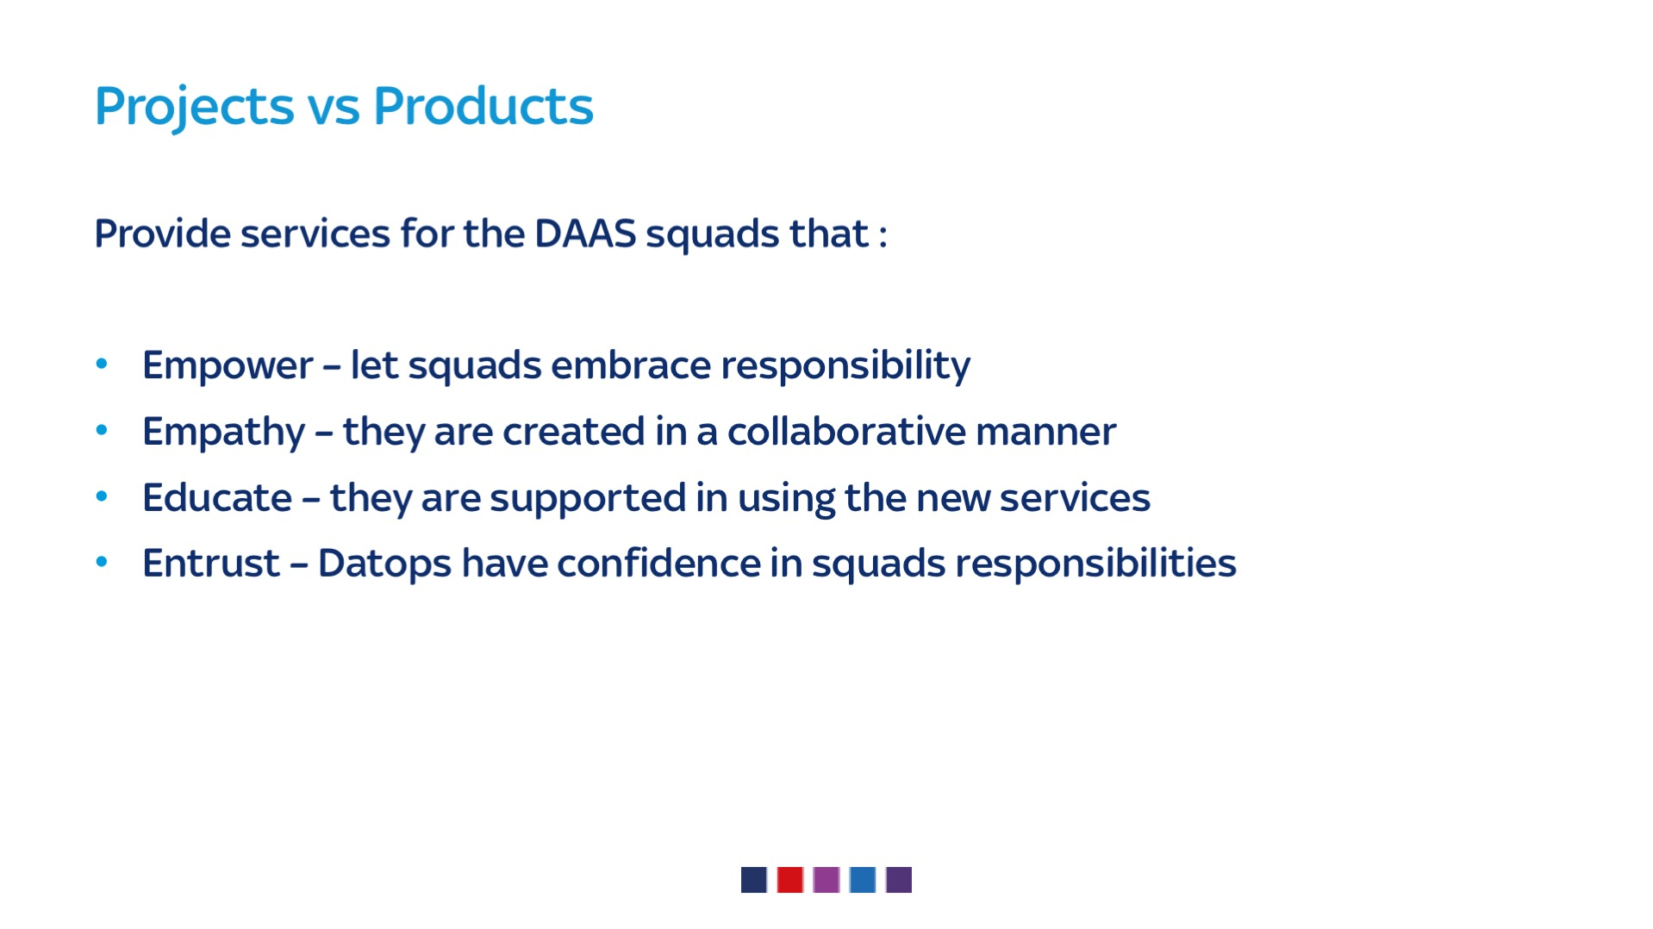
Notes:
APPROACH is important
4Es – make sure the team can..
embrace their new responsibilities
in an collaborative and informed way
be sure that everyone is comfortable with

Slide 35
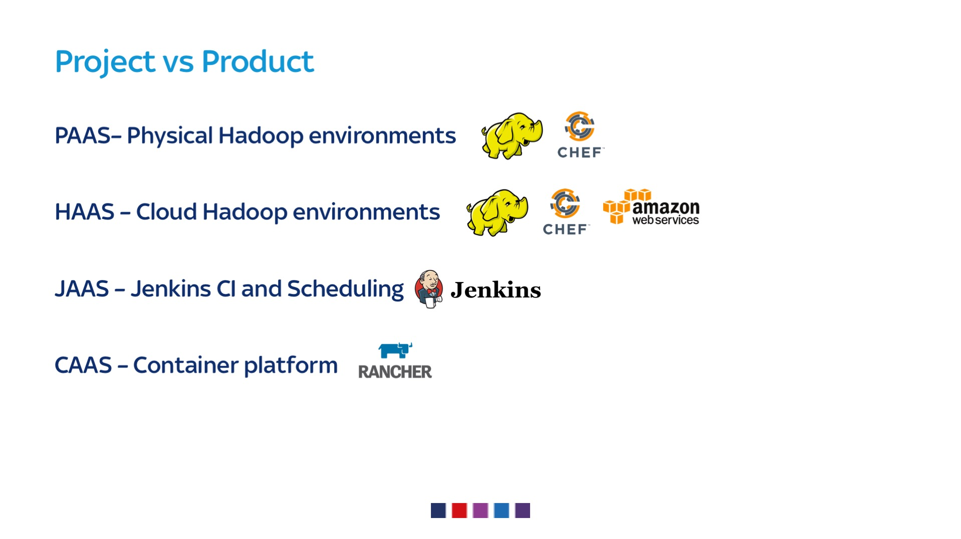
Notes:
PAAS – what we’d always been doing
HAAS – cloud offering with self serivce funtion using the IAC tooling
JAAS – lots of jenkins for CI and sched – generic version with tooling to migrate jobs synced to version control
CAAS – wary of “just give us docker” spreadin and putting in a container platform to make that manageable

Slide 36

Notes:
How do we deliver products ?
Pheonix project spoiler alert

Slide 37
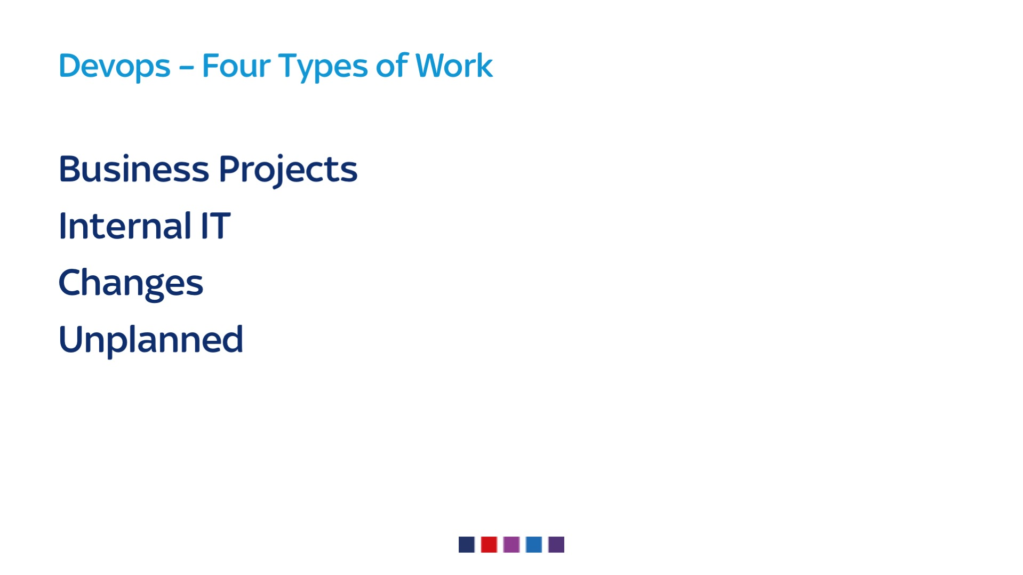
Notes:
Business Projects – so that list of make and do
Internal IT – our systems, non functional stuff – backups, monitoring, upgrades, better tooling
Changes – generated by the above
Unplanned – sometimes recovery – Toxic stops the others happening
Do everything you can to reduce or manage the unplanned

Slide 38
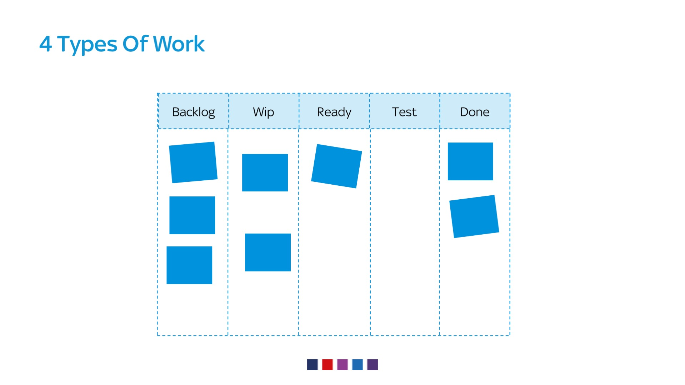
Notes:
Disciplined on how we managed work
Everything logged
No black market or doughnut buying

Slide 39
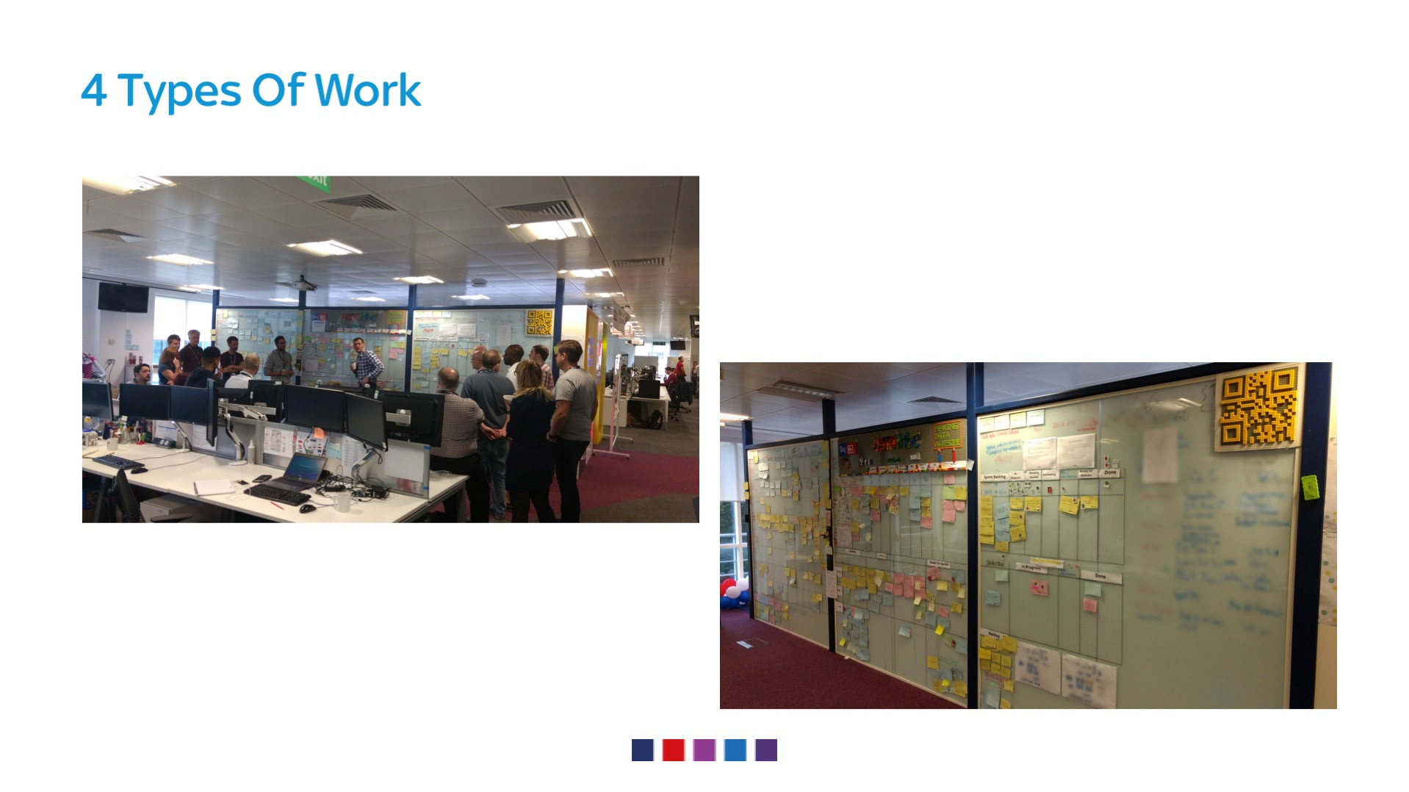
Notes:
How do devs manage dev work
Standup
Boards
Look at dev board

Slide 40
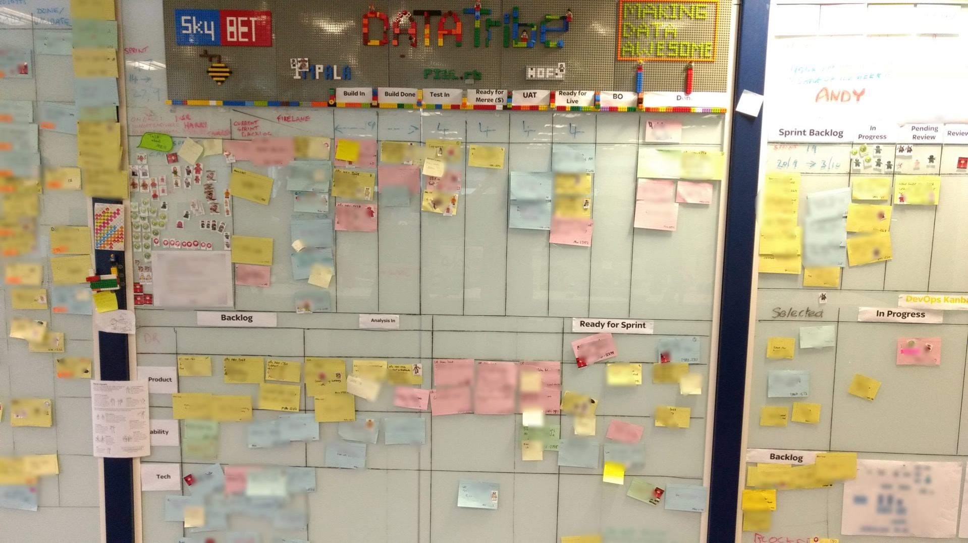
Notes:
BACKLOG down ere – prod owner, BAS, arch, lead devs
2 week sprints – refinement, planning, story points, retro and delivery analysis – scrum master

Slide 41
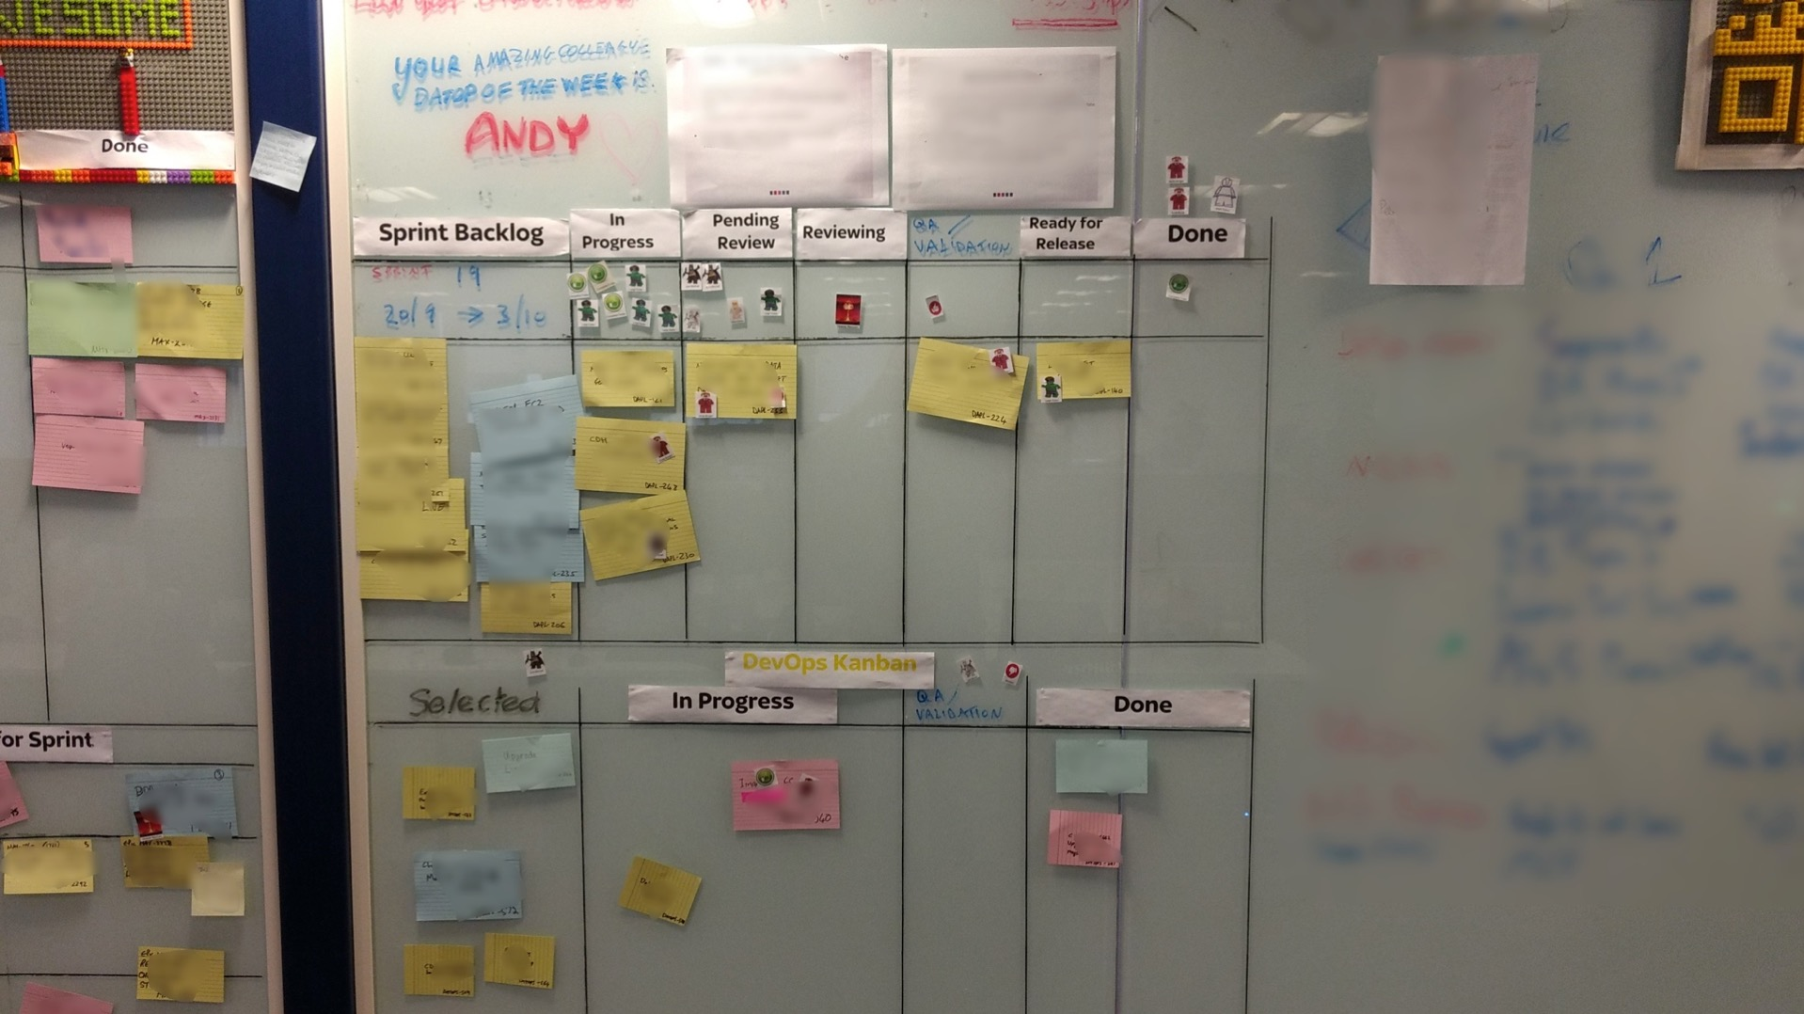
Notes:
New platform agile board
Run same as devs
2 week sprints – refinement, planning, story points, retro and delivery analysis – scrum master
Kanban still needed – FDOOTW - took the unplanned work problem head on
1 week bah
3 weeks tooling, iac using skills employed for

Slide 42
Notes:
Changed attitudes – working on stuff they wanted to

Slide 43

Notes:
So what have we found

Slide 44
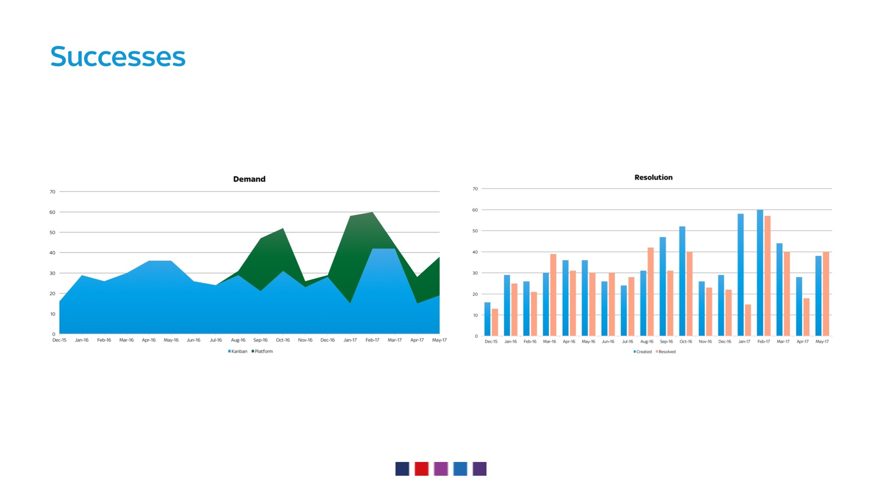
Notes:
We actually did more work after we implemented the platform board
Dip at xmas
Dip when big projects came in
Resolution not being outpaced by demand – so no backlog build up

Slide 45
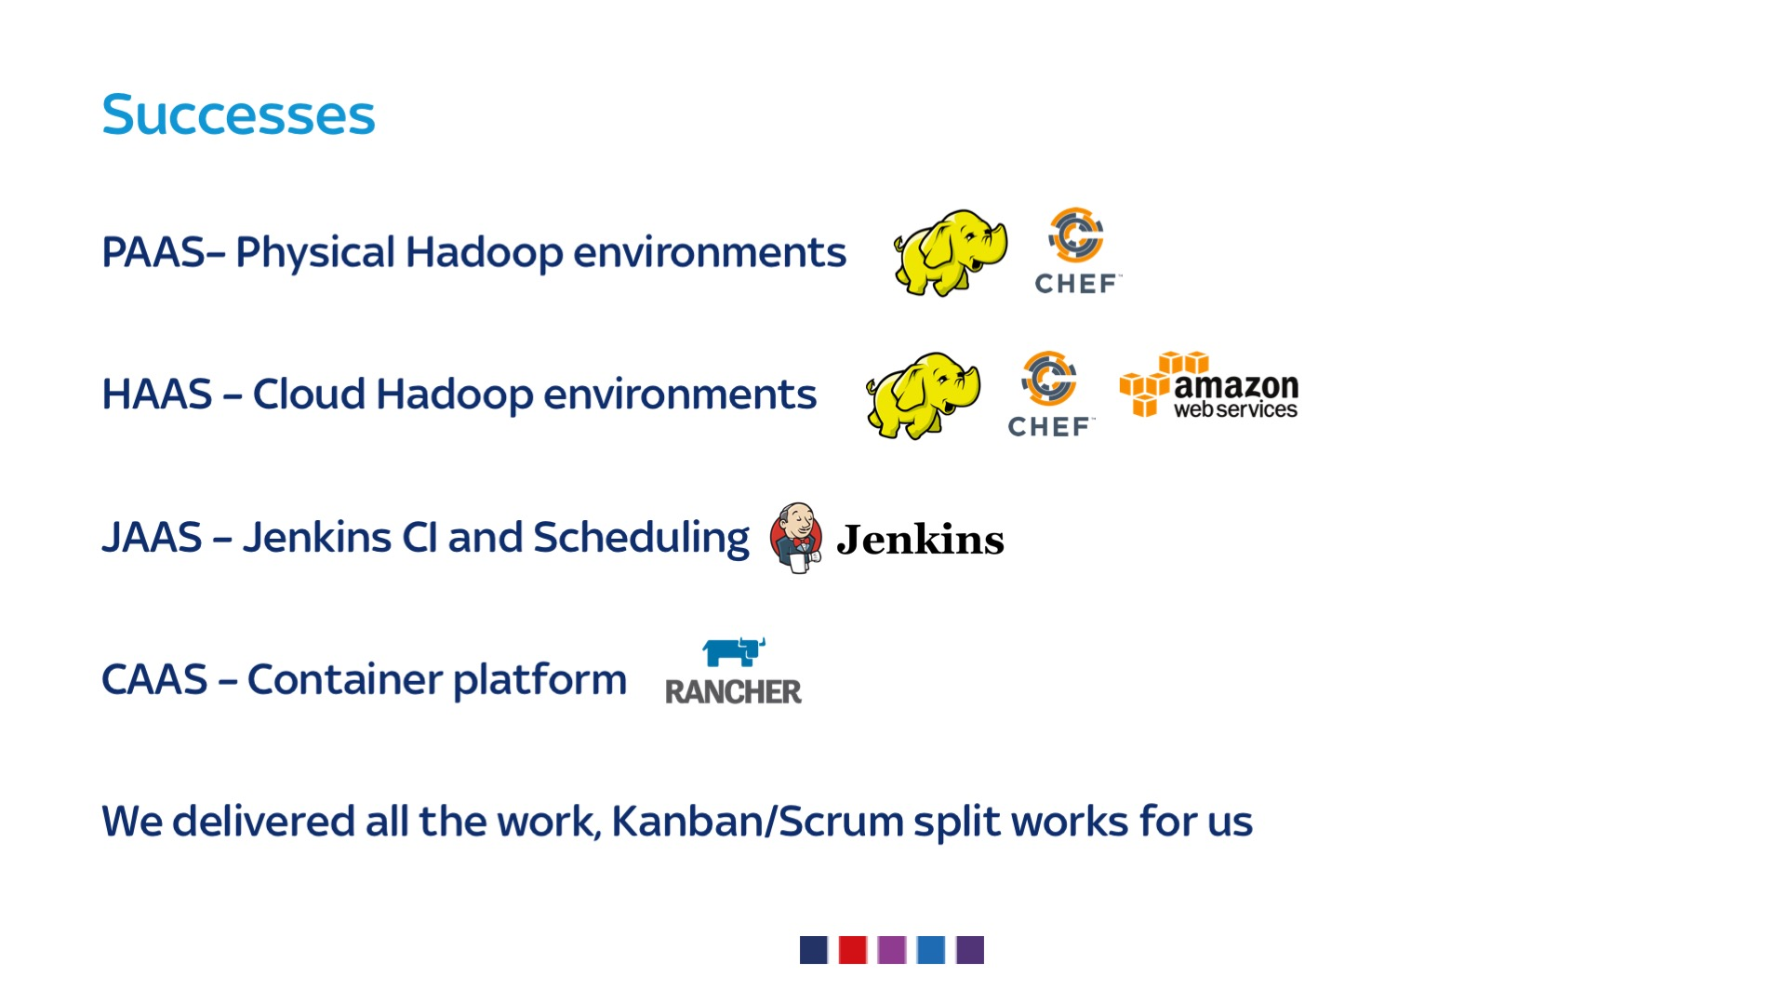
Notes:
PAAS – de snowflaked, more reliable
HAAS – did work, stalled because of security, all teams working with them to allow cloud delivery
JAAS – worked like a dream, embraced the tooling to move jobs, devs love having their own up todate version of jenkins
CAAS – just waiting on firewall rules and rollout slowly
Delivered all the work – too unplanned head on and effectively wip limited it by a single engineer

Slide 46
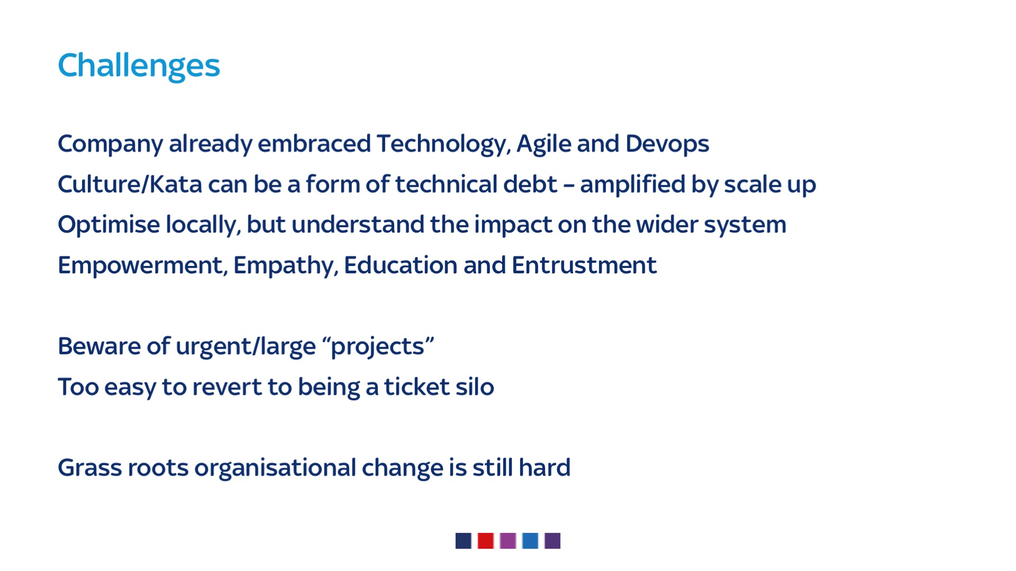

Slide 47
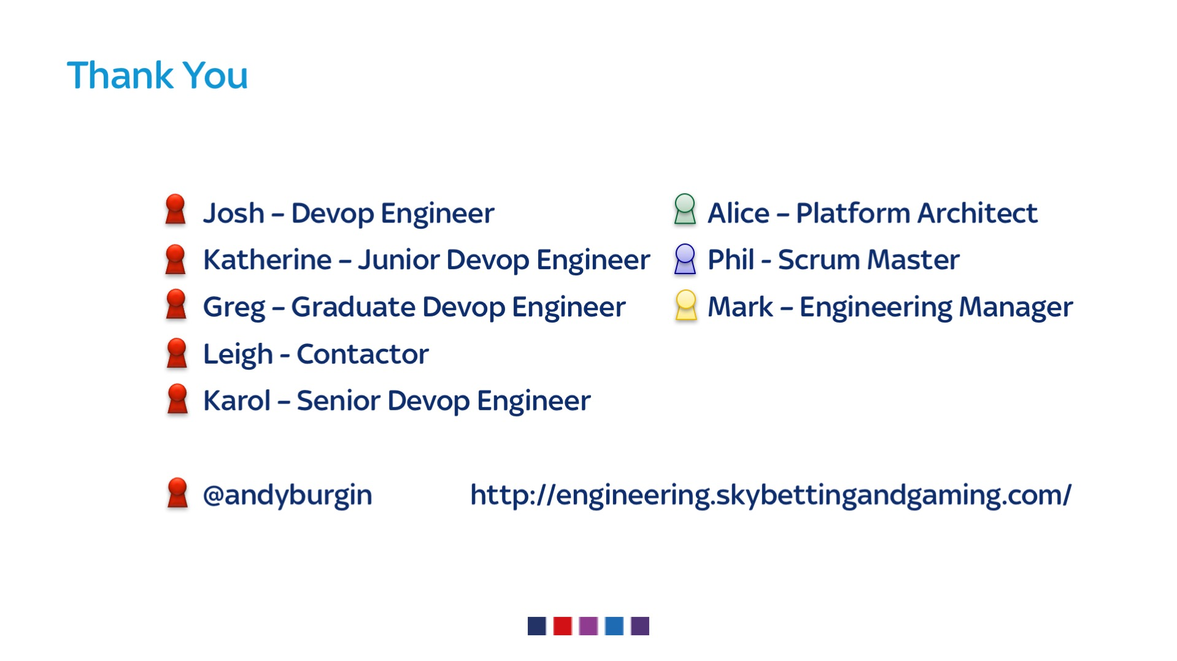
Notes:
Thanks to the team, past and present, this is their story too
Questions – twitter here for a couple of hours
Blog – data, also webscale gaming and bet too

Slide 48
